Slide 1
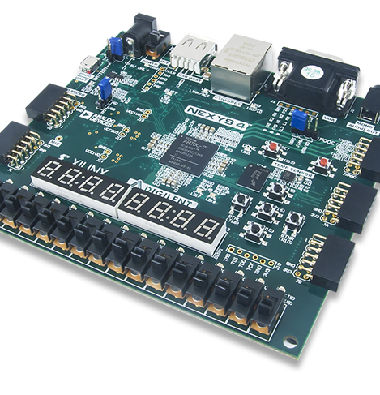
Lab 5
Group_D:
Laurice Sattouf
Choi Tim Anthony Young
Dimitri Garcia
Professor:
Mohamed El-Hadedy
California Polytechnic State University Pomona, California

Slide 2
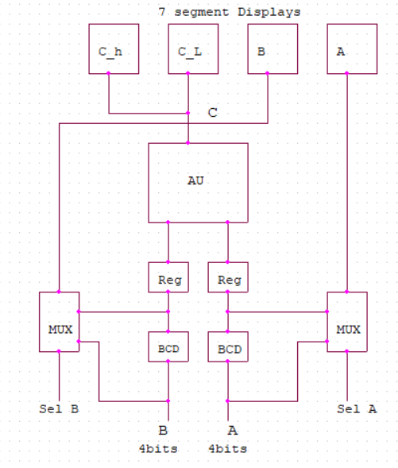
Assignment
Design an Arithmetic unit that could perform adding, multiplying, subtraction, and division.
The two inputs are 4 bits each and should be displayed in hex and BCD on the 7segment displays based on the select signals.
The result is displayed on the displays as A, B and C(low and high).
All possible corner cases was defined using a testbench textio.

Slide 3
Coding Steps
BCD converter for input A
BCD converter for input B.
Tow N bit registers to save the values of the binary and the BCD input value for A and B.
Multiplexers to select between the binary and the BCD values that needed to display.
AU component to perform all the operations needed.
7segment unit.
Top entity to wrap all the component together and create the desired design.

Slide 4
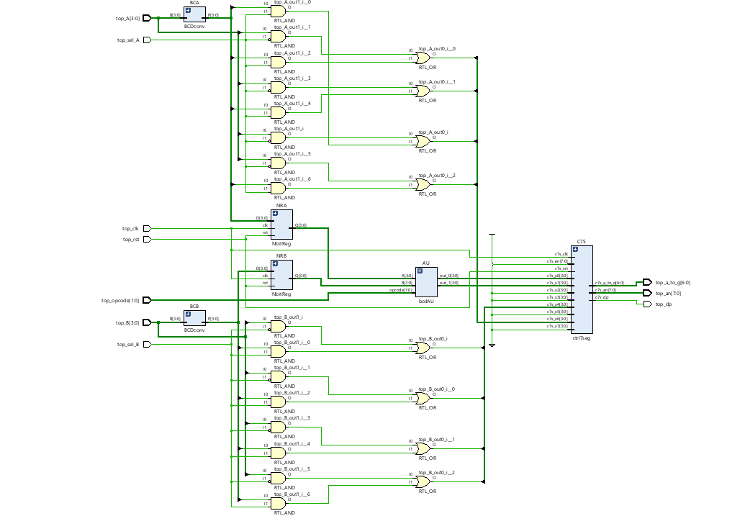
Schematic

Slide 5
Power and Resources

Slide 6

Work Distribution
We had a meeting to brainstorm and explain the main idea of the lab, and we created the schematic so that everyone would work individually to achieve the most optimized design.
We had a zoom meeting to choose the design with less power consuming, then we were able to demo our implemented design and cover all the corner cases.
Documentation and reports were evenly distributed, and it covered all the steps of our successfully implemented design.

